Slide 1
Construction (6-12 months)
Development (3-4 years)
Operation (>25 years)
0 1 2 3 4 5 6 7 8 9 10 15 20 25 years
Commissioning
Final owner take-over
Provisional Acceptance
Certificate (PAC)
Final Acceptance
Certificate (FAC)
2 year EPC warranty period

Slide 2
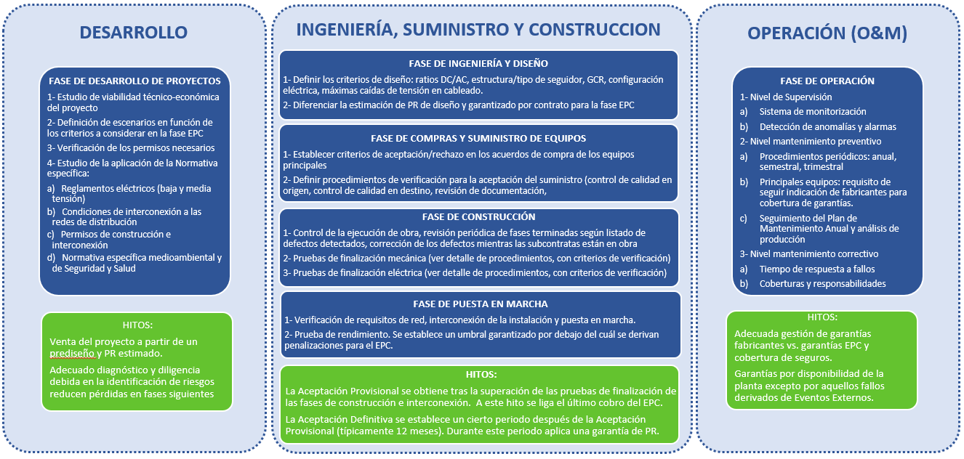
DEVELOPMENT
Concept development and site identification
Basic technical design
Feasibility analysis and economical optimization
Detailed technical Design
ENGINEERING, PROCUREMENT, CONSTRUCTION
Engineering
Procurement
Construction:
Civil works
Mechanical works
Electrical works
Commissioning
OPERATION
Remote supervision
Preventive maintenance
Corrective maintenance
MILESTONES
MILESTONES
Cold and hot commissioning
Provisional Acceptance Certificate (PAC)
Final Acceptance Certificate (FAC)
MILESTONES

Slide 3
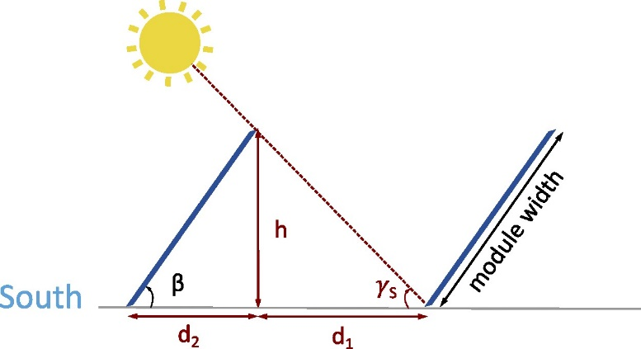
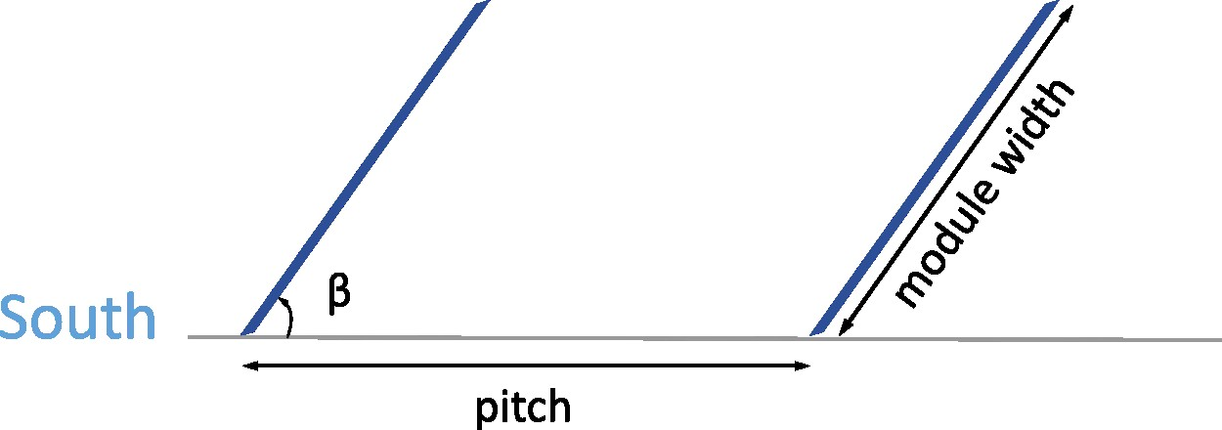
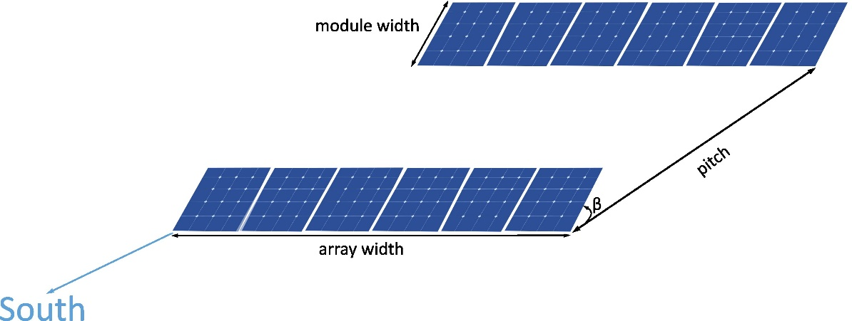







$$L$$
$$h$$
$$γ_{s}$$
$$β$$
$$a$$
$$b$$
$$d_{pitch}$$

Slide 5



MV/LV transformer
MV inner grid
grid connection
LV/MV transformer
inverter
=
=
main DC wire
Supervisory control and data acquisition
SCADA
combiner box
String of PV modules
Weather station

Slide 6
string inverters central inverter
LV/MV transformer
inverter
=
combiner box
=
=
=
string of PV modules

